Slide 1
SynthSense
Brainstorm
Krishna Parashar | Frank Lu | Adithya Murali | Craig Hiller | Tomás Vega

Slide 2
We Brainstormed...

Slide 3
The Big 5
Navi: A navigation dashboard with HUD display that integrates hand gestures and voice inputs to ensure safe driving.
PillPauper: A container that holds medicine, daily supplements and dispense appropriate amount of medication configured by health professionals.
Travis: power plugs that monitors power usage and upload to an online dashboard to reduce power consumption.
Self Moving Furniture: Computer controlled motors that move furniture.
SynthSense Tactile feedback for the blind.

Slide 4
So...what did we decide on?

Slide 5
SynthSense

Slide 6
What is SynthSense?

Slide 7
A simple solution to help the vision impaired feel the world without a low feedback cane.
You just need to wear the device.

Slide 8
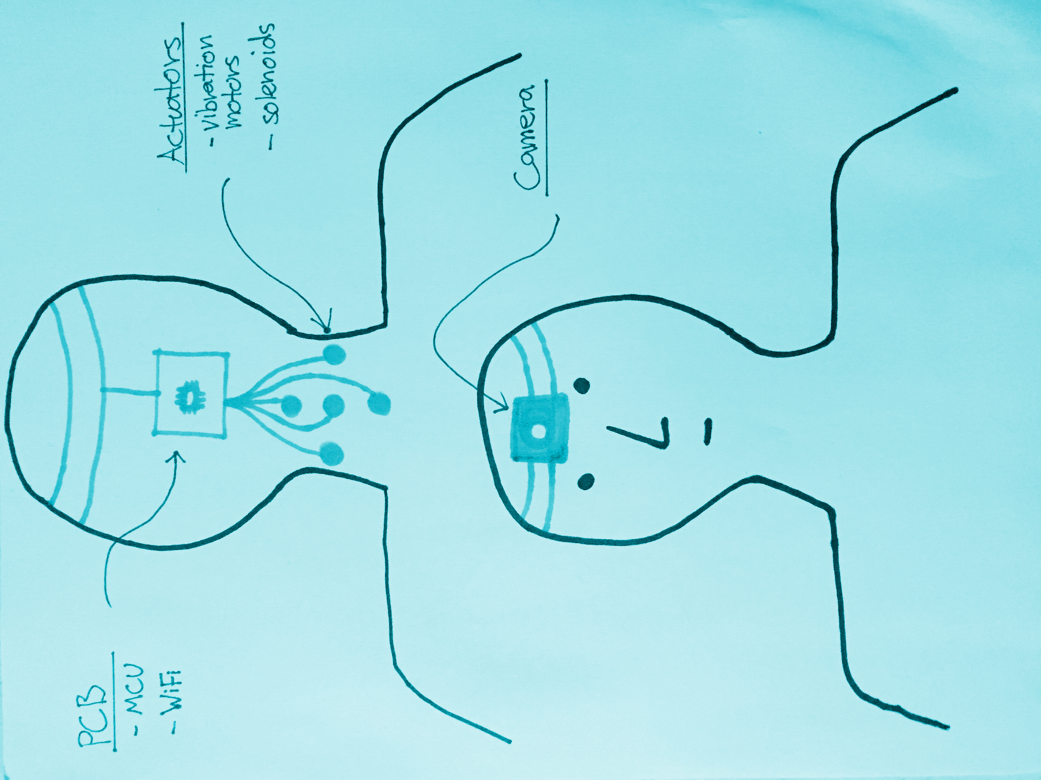
Camera feeds in images.
Features are extracted from images using a Raspberry Pi.
Features are then translated to haptic feedback.

Slide 9
Who can we help?

Slide 10
We provide the sensory reassurance using an alternate feedback system with direct information.

Slide 11
The Blind
The Visually Impaired
The Endless Possibilities

Slide 12
Why SynthSense?

Slide 13
1
The Potential to have a very meaningful impact.
It Improves the life quality of many people.

Slide 14
2
Human augmentation is a fascinating field.
We want to push the limits of neuroplasticity.

Slide 15
3
We have the skills.
Machine Vision, HCI, Cognitive Neuroscience
Embedded Systems, Product Design, Rapid Prototyping

Slide 16
What are our challenges?

Slide 17
Can we have a depth camera on an embedded platform?
What should we use for actuators?
Is the bottleneck at the hardware, or at the sensory level on the body?
What is the optimal placement and number of actuators?
How much information can we provide without reaching cognitive overload?

Slide 18
Questions, Criticisms, Comments?

